Slide 1
Security Controls in Shared Source Code Repositories
Kimberly Orozco
CSD380-T301 DevOps
November 15, 2025

Slide 2

Why Security in Code Repositories Matter
Keeping code safe is very important so it’s really bad if code gets stolen or leaked from your repositories, this is what can happen:
Competitors can easily copy your work.
Hackers can find and exploit holes in your code.
Your company can lose a lot of money AND reputation.

Slide 3

Create a Source Code Protection Policy
Having a policy in place helps everyone know how to work with and protect code. According to Endpoint Protector this policy should have:
Rules for using repositories
Training on secure coding
Strategies for encrypting code and app protection

Slide 4
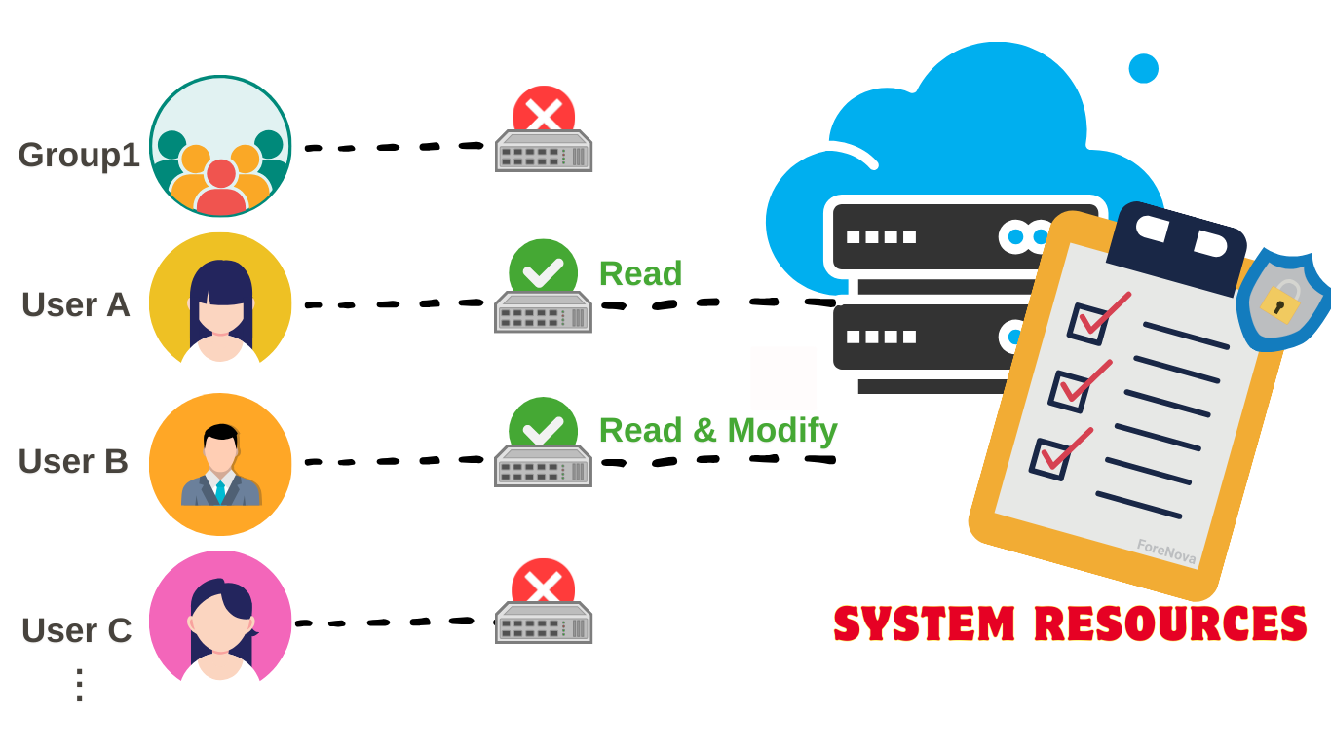
Control Access to Your Code
There isn’t a need for everyone to have access to certain code, so there should be clear rules on who gets access to what. Like,
Only letting necessary employees in
Use Two-Factor Authentication
Track and monitor access logs

Slide 5

Best Repository Practices
Review code before merging
Protecting main branches from unreviewed changes
Pinning dependency versions to avoid attacks
Using actively maintained libraries
Minimizing binary files in repositories
Test the CI Pipeline
Source: (Rose, 2025)

Slide 6

CI/CD and Automated Security Checks
Using automated tools can catch problems early on and lead to less issues when using them. They can:
Test code in CI pipelines
Run fuzzing tests to find any vulnerabilities
Watch for any risky GitHub Action workflows
Source: (Rose, 2025)

Slide 7
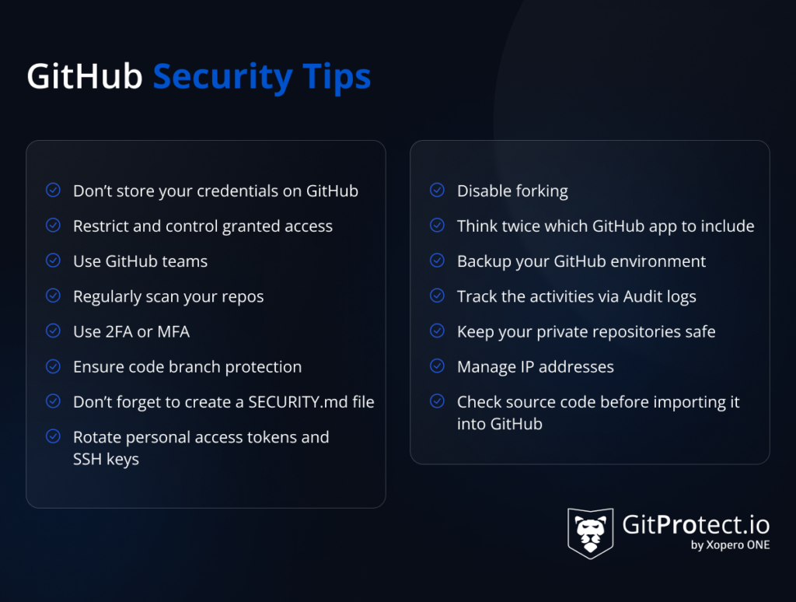
Extra Security Measures
Encrypt code
Monitor for suspicious activity
Protect endpoints with DLP tools
Use network security tools like firewalls and VPNs
Source: (Kulikova, 2024)

Slide 8
Works Cited
Berecki, B. (2022, June 10). Best practices for source code security. Endpoint Protector Blog. https://www.endpointprotector.com/blog/your-ultimate-guide-to-source-code-protection/
Kulikova, D. (2024, December 11). GitHub security best practices - 15 tips to keep in mind - blog. Blog | GitProtect.io. https://gitprotect.io/blog/github-security-best-practices-15-tips-to-keep-in-mind/
Rose, J. (2025, July 24). 12 best practices for Secure Code Repositories (2025 guide). Checkmarx. https://checkmarx.com/supply-chain-security/repository-health-monitoring-part-2-essential-practices-for-secure-repositories/

